Slide 1
AR Lib: An Augmented Reality Library for Application using Unity
DOMAIN: Augmented Reality
BATCH A6
TEAM MEMBERS:-
2018PECCS101: AARTHI.R
2018PECCS104: AISHWARYA.C
2018PECCS109: ANNIE DIVYA.D
PROJECT COORDINATOR: PROJECT GUIDE:
Dr.L.JABASHEELA A.KANCHANA

Slide 2
ABSTRACT
Here we propose an interactive library management system that can be used make library more appealing. This application can be created in two sections one section acts as a server that holds information of every book available in library and second section is a mobile application that can access this database. This application should be installed in every library user’s phone. The phone camera can be used to see the AR interface in the library, phone application can scan different visual markers in different parts of the library. This scanning result will show the type of books in that section of the library in details, this is more convenient compared to a note that can only give little information. This result will also contains a list of all books available in that section. If the user want browse through books if he/she not looking for a particular book then user can scan the cover of a book to just get all the information about the book online and offline. This application can reduce the complexity of managing a library by many folds.

Slide 3
EXISTING SYSTEM
Conventional libraries with manual help
Computerised libraries with less interactive systems
Libraries with systems only accessible to staff

Slide 4
PROPOSED SYSTEM
Centralised library management system
More interactive
Based on augmented reality applications
Can be used by both user and library staff
Has two sections
Library section acts as server and for admin access
User section in the form of a mobile application
Camera based AR application

Slide 5
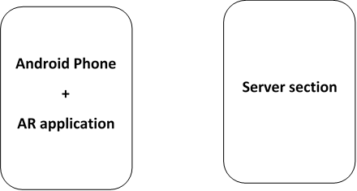
Diagram

Slide 6
BLOCK DIAGRAM DESCRIPTION
This system consists of two sections
One user interface, an android application
One server section, a server and admin access
Mobile application is a camera based AR application
The app is developed using Unity platform
Server can be java based server with simple user interface for the library staff
Both are connected through local network in this case

Slide 7
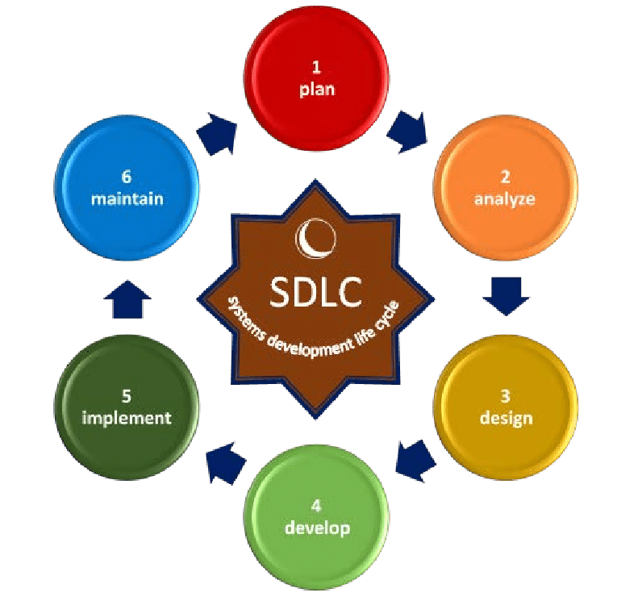

Slide 8
SOFTWARE TOOLS USED
Unity 3D
Vuforia
Android Studio

Slide 9
HARDWARE TOOLS USED
Android phone

Slide 10
REFERENCE
[1] A. Syberfeldt, O. Danielsson, and P. Gustavsson, ‘‘Augmented reality smart glasses in the smart factory: Product evaluation guidelines and review of available products,’’ IEEE Access, vol. 5, pp. 9118–9130, 2017.
[2] X. Qiao, P. Ren, S. Dustdar, and J. Chen, ‘‘A new era for Web AR with mobile edge computing,’’ IEEE Internet Comput., vol. 22, no. 4, pp. 46–55, Jul. 2018.
[3] M. Makar, V. Chandrasekhar, S. S. Tsai, D. Chen, and B. Girod, ‘‘Interframe coding of feature descriptors for mobile augmented reality,’’ IEEE Trans. Image Process., vol. 23, no. 8, pp. 3352–3367, Aug. 2014.
[4] T. Engelke, M. Becker, H. Wuest, J. Keil, and A. Kuijper, ‘‘MobileAR browser—A generic architecture for rapid AR-multi-level development,’’ Expert Syst. Appl., vol. 40, no. 7, pp. 2704–2714, Jun. 2013.
[5] D. Chatzopoulos, C. Bermejo, Z. Huang, and P. Hui, ‘‘Mobile augmented reality survey: From where we are to where we go,’’ IEEE Access, vol. 5, pp. 6917–6950, 2017.
[6] C. Marrin. Webgl Specification [EB/OL]. Accessed: Apr. 4, 2020. [Online]. Available: http://www.khronis.org/registry/webgl/
[7] M. Baker and J. Manweiler, ‘‘Views of current and future technology,’’ IEEE Pervas. Comput., vol. 16, no. 2, pp. 9–13, Apr. 2017.
[8] E. G. Larsson, O. Edfors, F. Tufvesson, and T. L. Marzetta, ‘‘Massive MIMO for next generation wireless systems,’’ IEEE Commun. Mag., vol. 52, no. 2, pp. 186–195, Feb. 2014.
[9] H. Hoppe, ‘‘Progressive meshes,’’ in Proc. 23rd Annu. Conf. Comput. Graph. Interact. Techn., 1996, pp. 99–108.
[10] R. Pajarola and J. Rossignac, ‘‘Compressed progressive meshes,’’ IEEE Trans. Vis. Comput. Graphics, vol. 6, no. 1, pp. 79–93, Jan./Mar. 2002. [11] A. Maglo, I. Grimstead, and C. Hudelot, ‘‘POMAR: Compression of progressive oriented meshes accessible randomly,’’ Comput. Graph., vol. 37, no. 6, pp. 743–752, Oct. 2013.

